Slide 1
Airbnb Rating system: Rational or Emotional?
Notes:
Judging by the millions of reviews left by guests on the Airbnb platform, this “trusted community marketplace” is successfully fulfilling its mission of matching travelers with hosts. It is one of the biggest examples of a shared economy.
Online reviews are a significant driver of consumer behavior, providing a way for consumers to discover, evaluate, and compare products and services on the web. However, based on our analysis, we realized that reviewers are often incentivized to provide ratings higher than that implied by their review text.

Slide 2
Business Problem
1
Is the current rating system likely to reflect true productivity of listings?
Notes:
As a customer, or any other individual interested in determining the quality of the listing, we would want to get an accurate indication of the quality of the property.
The aggregated property rating is often not a very accurate indicator. As an example, the average rating for all listings across Airbnb stand at 4.7 with 94% of all the listings being rated above 4.5. This is much higher than ratings on other hotel sites like TripAdvisor. Multiple reasons can lead to these potential differences.
Ratings can be impacted by herding behavior, where prior ratings can bias the evaluations of subsequent reviewers.
There could be a cases of under-reporting of negative reviews, where reviewers fear retaliatory negative reviews on platforms that allow and encourage two-sided reviewing.
Sometimes customers that are more likely to be satisfied with a listing are also more likely to book and review it.

Slide 3
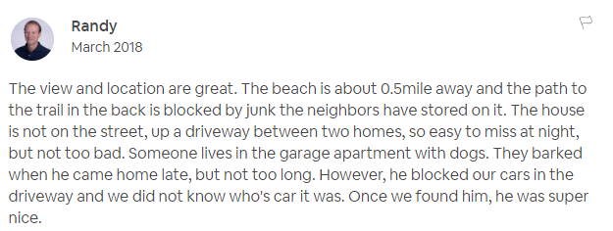

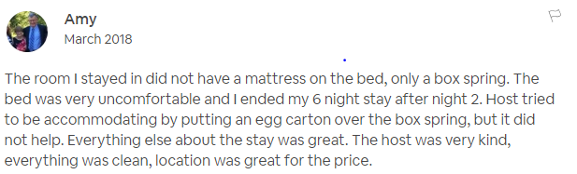

Perfect 5 star ratings
Notes:
We can see from these examples that the concerned listings have some negative reviews, but the perfect 5 star rating does not reflect the same
For a customer, it can often become tedious to go through 100 odd reviews for each listing before zeroing in on a choice

Slide 4



Is it a good investment? Does it have value?
How is our reputation impacted? Are users coming back?
Will we come back here? Will we recommend this to our friends?
6% LISTINGS
33% REVENUE
Notes:
The next question that organically comes up, is who is it of worth to? Who benefits from this.
As such, a better and more accurate rating would create value for multiple stakeholders. Airbnb is one of the first and most obvious gainers.
At the platform level, a recent study shows that eBay buyers draw inferences about the eBay marketplace based on their experiences with specific sellers. Buyers who have a poor experience with any one seller are less likely to return to eBay. These kind of studies suggest that providing good service is essential not only to individual hosts but may be central to Airbnb’s success as well. Thus it becomes important for Airbnb to recognize the genuinely good listings.
An organization like Airbnb, that essentially mimics a trusted community marketplace, is driven by reputation and its market evaluation is strongly impacted by how hosts performance.
Then there are customers. Ratings directly influence customer choices and decisions. Once again, going through all reviews for all potential properties can get tiresome. An all inclusive score that accounts for reviewer sentiments would add value for customers as they have a one stop app with one metric to be concerned with.
Finally, there is a third taker of the new rating. Handling such establishments involve a lot of funds. There are investors who track ratings and property performance to choose their investments. A more accurate rating system would add more confidence in their decision making process.
Airbnb might perceive an incentive in skewing the ratings up, but this can actually be a short sighted move since the review text indicates actual user experience which impact future bookings.
There is value add for all 3 stakeholders, but the monetary benefit is most immediate for investors.

Slide 5
Hypothesis
2
Could there be a better rating system?
Notes:
This brings us to the next question. Could there be a better rating or scoring system that could be derived from the same amount of information. In other words, is there a way to derive the underlying emotions of reviewers and discount their tendency to inflate ratings.
Essentially, we need a clear hypothesis to begin with.

Slide 6
Hypothesis: The current rating system involves noise. A more accurate rating can be derived by accounting for user sentiments expressed in reviews
Notes:
And based on our observations and expectations, we frame our hypothesis as follows. The current rating system includes noise. A more accurate rating can be derived by accounting for user sentiments expressed in reviews.
Once we have identified what could potentially add value to the system, we zeroed in on how we could account for this information and developed an algorithm to achieve our goal.

Slide 7
Impact of New Rating System on different reviews
Review: Great Service
Great Service
Final New Rating
Review: Great Service, but room could be available on time. Rooms could be cleaner. Overall service could be better
Airbnb Rating
Great Service
. . . , but room could be available on time
. . . , but rooms could be cleaner
. . . , but Service could be better
Final New Rating
Notes:
This slides gives a high level idea regarding how we intend to account for user sentiments and filter out the cognitive biases.
We consider a situation where there are 2 listings with the same overall rating and with one user review each. However.
One listing has a review that just says: ‘Great service’. So when we look at the sentiment score, it is at +1. Thus we accept the high rating as is.
However, when the review says ‘Great Service, but room could be available on time. Rooms could be cleaner. Overall service could be better ’, we identify some room for improvement and want the rating to reflect that.
So we want to weigh the rating down by the magnitude and direction of the emotional content of the reviews.
This can be observed in the second case, where the overall rating is impacted for each negative sentiment

Slide 8
Analysis approach
3
How do we calculate the new ratings?
Notes:
So far, we have identified the factor that could be indicative of true rating of a listing and established how we would like it to impact the final rating. This brings us to the part where we quantify our intuitions.

Slide 9




Implementation Algorithm
*
Review data scraped from the Airbnb website and cleaned for analysis using Google API
Natural Language API identifies the language and performs sentiment analysis**
Each review is assigned a score indicating the emotion of a review and a magnitude indicating how emotional it is
* Output used:
Score: Emotion of review
Magnitude: How emotional is the review
** For unidentified languages, Google Translation API before conducting sentiment Analysis
Notes:
The next two slides discuss the process flow involved in the study.
The first step involves scraping relevant data from the Airbnb website, cleaning it and making it ready for further analysis.
Although, it is quite feasible to tokenize the reviews, tag them grammatically and perform sentiment analysis using available lexicons or through machine learning directly on Python, we chose to use the Google NLP API, that has a very sophisticated algorithm already in place, accounting for different metrics.
The API automatically detects languages that it can handle, and for all other languages, we are using google translate API to translate the review and then feeding it back to the NLP API.
Google NLP API provides the emotion as well as the magnitude of emotional content associated with each review.
We are utilizing 2 outputs from this step. First, the emotion itself, and second the extent to which the review is emotional.

Slide 10


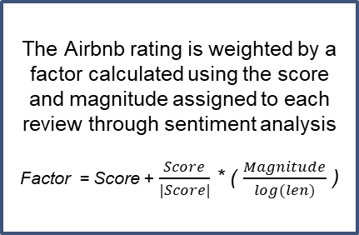
The Airbnb rating is weighted by a factor calculated using the score and magnitude assigned to each review through sentiment analysis
Factor = Score + $\frac{Score}{|Score|}$ * ( $\frac{Magnitude}{log⁡(len)}$ )
No of bookings per listing is extracted as recorded on the 20th of every month and a booking rate is determined.
Booking rate is regressed separately on each of the rating systems and the better predictor is identified
Notes:
Now, we calculate a sentiment factor using formula shown. This formula is used to weigh the rating listed by Airbnb.
Once we have the new rating, it is time to quantify if it is really better and to what extent. We run 2 simple linear regression models for number of bookings against ratings. For the first model, we use the rating that we get from Airbnb. For the second model, we use the our modified rating system

Slide 11

Measures and Models
Measures | Model 1 | Model 2
Model Type | Simple Linear Regression | Simple Linear Regression
Target Variable | Booking Rate | Booking Rate
Predictor | Rating = Airbnb rating | Rating_new = Airbnb rating * Factor⁺
Co-efficient | 0.33 | 0.44
P-value for rating | 5.9 e-13 | <2 e-16
R-squared value | 1.4% | 1.9%
Correlation | 0.12 | 0.14
⁺Score derived from sentiment scores: Factor = Score + $\frac{Score}{|Score|}$ * ( $\frac{Magnitude}{log⁡(len)}$ )
Notes:
We then compare the results to see if the new rating system is a better predictor or determinant of number of bookings without concerning ourselves regarding all other parameters.
This table presents the findings from both models. Since our goal is to see if the new rating system provides more confidence in the presence of a relationship, we are most interested in the p-value. It indicates that there is a higher statistical significance of the relationship between revenue and the individual rating systems.
Further there is a 35% increase in R-square value. We can see that this new variable explains more of the variation than the rating system.
Based on this finding, we would prefer the new rating system over the old one while determining revenue from a listing

Slide 12
Correlation Plots
Airbnb Rating vs. Booking Percentage
New Rating vs. Booking Percentage
Notes:
The correlation plots in this slide clearly show that that the new rating system follows the booking rate much more closely than the original rating system.

Slide 13
Recommendations
4
How can we use this information?
Notes:
The immediate next step involves deciding how we can use this information?

Slide 14

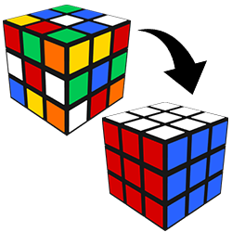
Recommendations
For Investors:
Use new noise free ratings to select listings with highest future potential (significantly reduce independent research efforts)
For Airbnb:
Update rating system on portal based on reviewer sentiments
Or, show 2 ratings: Average ratings and user sentiment ratings
Use sentiment ratings to prioritize host visibility
Notes:
The new rating system essentially removes noise from the current rating system, that is extensively used to gauge quality of a listing.
It is possible to predict performance of a listing or property with higher confidence with this new system. The benefits of this are best observed among investors that are looking for most prospective options. For all other parameters like ……., being constant, the new rating system becomes like a one stop shop for information, eliminating the need to reads 10s of 1000s of reviews across listings. This not only reduces their risk of investment, but also saves them time, which could easily translate to more opportunity for business.
Further, even Airbnb could use this rating to prioritize their host / listing visibility algorithm, ensuring a strong reputed market presence

Slide 15
Limitations and Future Scope
5
Could better data lead to better insights?
Notes:
The discussion now moves to a very critical aspect of the study. Could the results and findings be better if we had access to better data or clearer metrics of performance

Slide 16

Booking Data
15-Jan | 16-Jan | 17-Jan | 18-Jan | 19-Jan | 20-Jan | 21-Jan | 22-Jan | 23-Jan | 24-Jan | 25-Jan | 26-Jan | 27-Jan | 28-Jan | 29-Jan | 30-Jan | 31-Jan | 1-Feb | 2-Feb | 3-Feb | 4-Feb | 5-Feb | 6-Feb | 7-Feb | 8-Feb | 9-Feb | 10-Feb | 11-Feb | 12-Feb | 13-Feb | 14-Feb | 15-Feb | 16-Feb | 17-Feb | 18-Feb | 19-Feb
1st data capture
2nd data capture
Data is captured by Inside Airbnb once a month. Any booking activity taking place after 15th Jan for reservations between 16th Jan and 14th Feb is not captured anywhere
Notes:
One of the biggest challenges we faced was to get information regarding the actual demand for the listings or any data regarding their business performance.
After some research, we got access to some booking data that Inside Airbnb captures to indicate availability of the listings. However, data is captured once a month only and any updates or changes in bookings occurring for the immediate month over the next 30 days is not captured anywhere.
Thus, the booking metric is largely skewed.

Slide 17


Future scope
1
Regular and Accurate Booking data tracking
Scale up to develop model including other variables for all listings
Notes:
In the future, tracking booking data regularly would help develop a more accurate rating system. This can then be scaled up for application across the website.
In conclusion, we recommend that Airbnb adopts a new and updated rating system based on user sentiments, that can be used to closely determine the booking rates of listings.

Slide 18

Appendix
Additional Analysis and Graphs

Slide 19
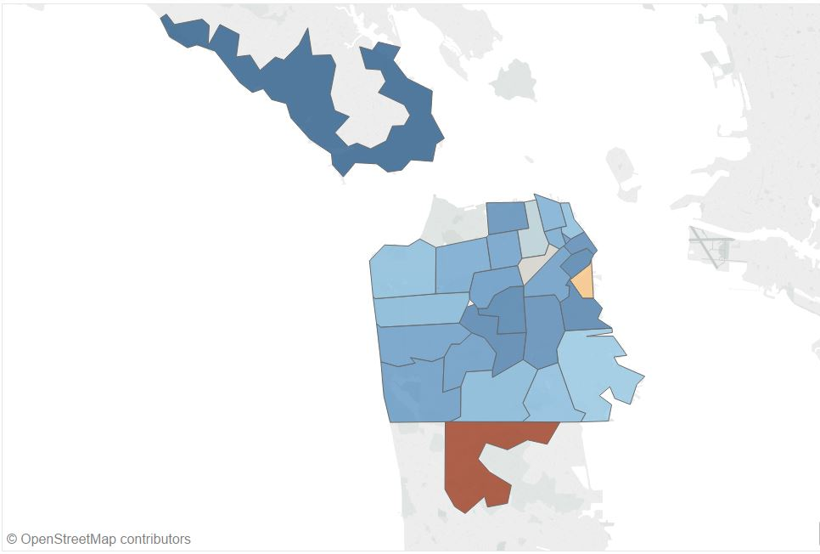
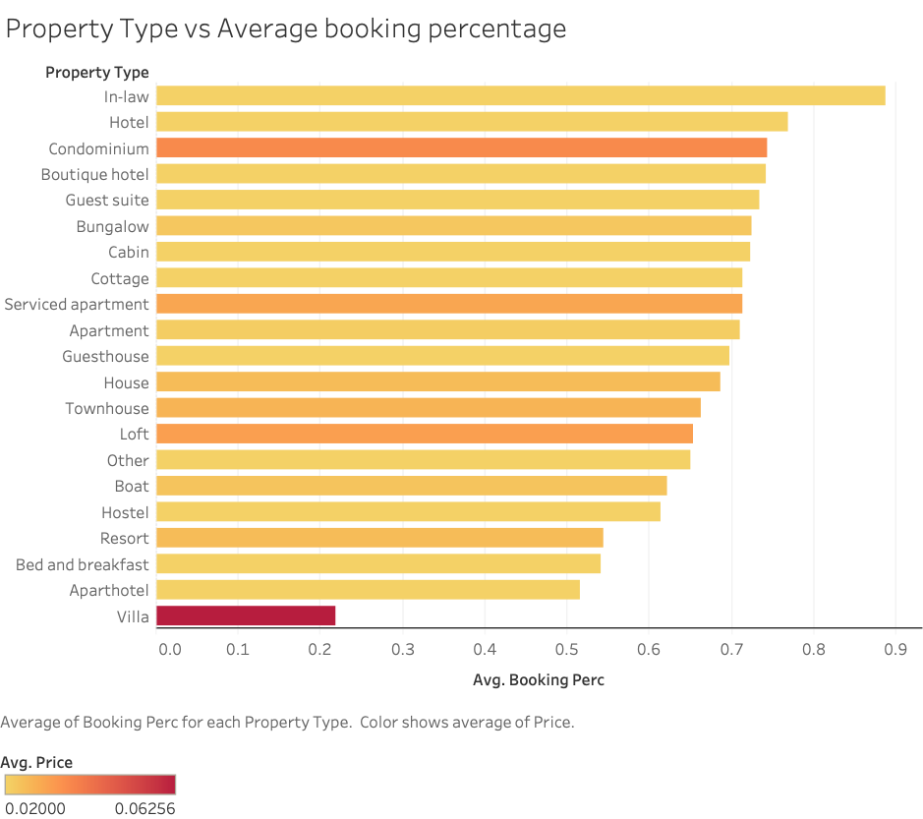
Influence of factors other than rating
Booking rates by Zip Code
Booking rates by property type and price

